Slide 1

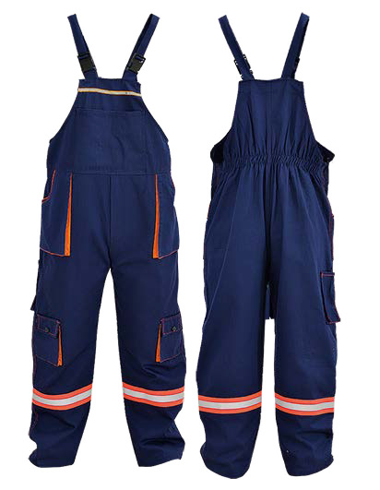
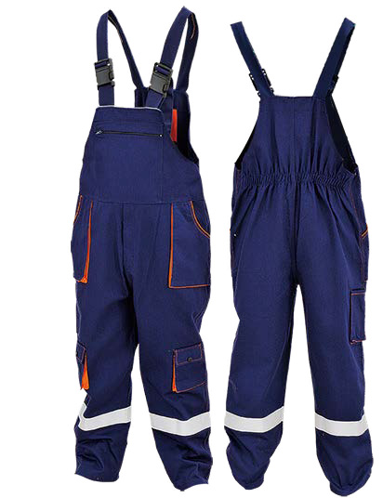
Safety Workwear
G-3035 Safety Workwear (Bib Overalls)
Material : 80% Polyster & 20% Cotton (Can Be Customized)
Reflective Tape: 2 CM Width TC & 5 CM Knitted Padding Cloth
Closure : Adjustable Straps With Buckles
Pocket: 1 Front Pocket & 1 Back Pocket
2 Front Slanted Pocket & 2 Accordin Pockets
Color Available: Grey, Blue, Black etc
Size : S,M,L,XL,XXL
CE EN ISO 11612:2015
CE EN ISO 1149:2008
Application : Construction, Road & Building Workers, Logistics & Warehouse Workers, Mechanics, Factory Workshop, Traffice Police, Gas Station & other General Purpose Workplaces etc
Users Instruction:
1.) APROVED STANDARD：
The workwear meet the European regulation EU 2016/425 on personal protection against mechanical risks. They meet all relevant technical EN-standards EN ISO 20471.
2.) USER PRECAUTION:
⚫ Check before use if the workwear do not show any defects. It is not recommended to use the workwear in the proximity of machines in operation. Do not use the workwear that are dirty because of the risks of dermatitis.
⚫ Some workwear can contain products that may cause allergic reactions. By preference keep the workweara in a dry place inside the original packaging. Keep the workwear away from any heat source.
⚫ The workwear don't offer protection against chemical fluids.
3.) LIFESPAN
The workwear can be expected to remain in service for 5 years or more, when it is in well stored condition.
4.) CLEANING
The workwear can be cleaned with a normal detergent at a maximum temperature of 40°C. After cleaning, the workwear generally keep their characteristics. Nevertheless, we cannot be held liable in case any safety properties are reduced.
5.) STORAGE
Store the workwear in a cool, dry and clean place out of direct sunlight. Avoid area where heat, moisture, light, oil, or their vapours or other degrading elements may be present.

